Slide 1

ECEN 361
Real-Time and Embedded Systems
Lecture 13 – VxWorks Development Environment

Slide 2
VxWorks RTOS
Memory
Management
Device
Support
Scheduling &
System Clock
Facilities
I/O
system
Synchronization
& Intertask
Communication
Mutual
Exclusion
File
Systems
. . .
Networking Support

Slide 3
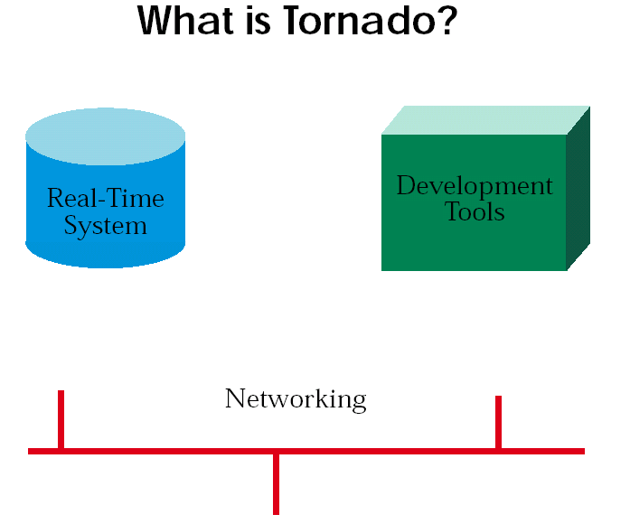
VxWorks RTOS

Slide 4
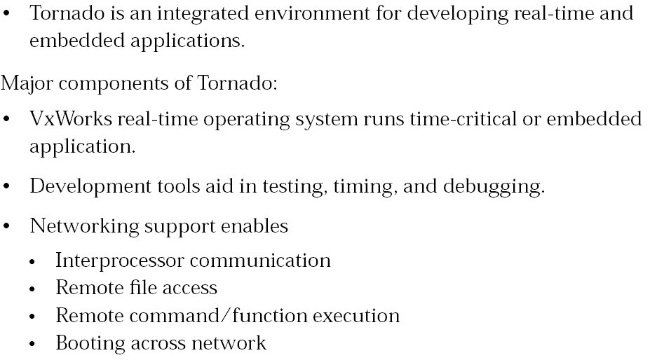
VxWorks RTOS

Slide 5
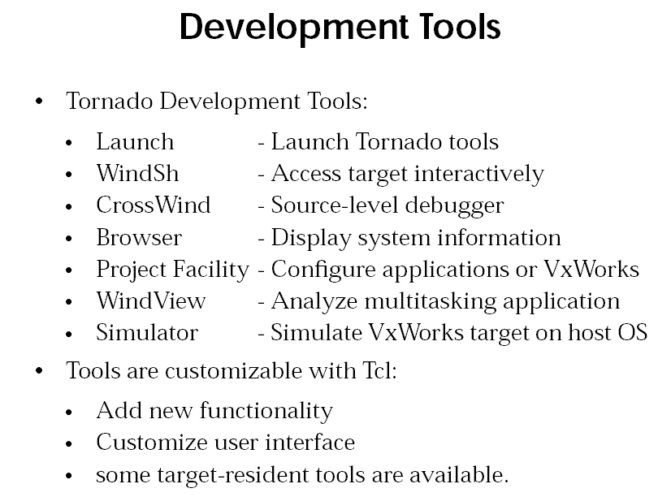
VxWorks RTOS

Slide 6
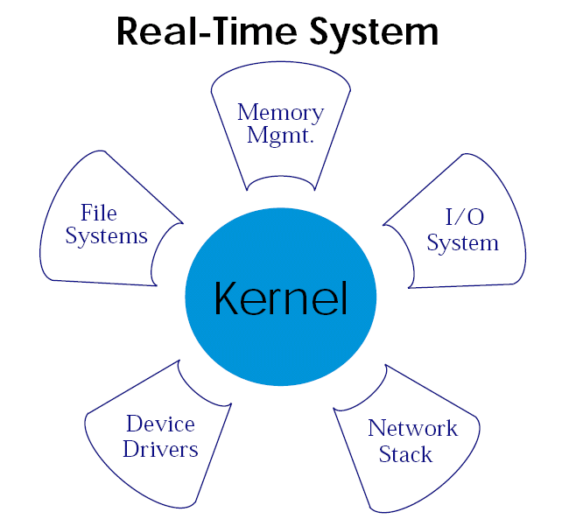
VxWorks RTOS

Slide 7
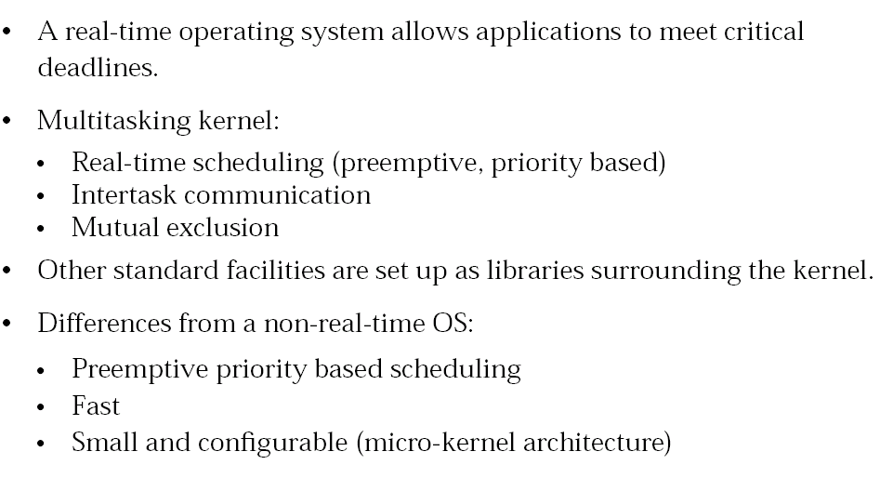
VxWorks RTOS

Slide 8
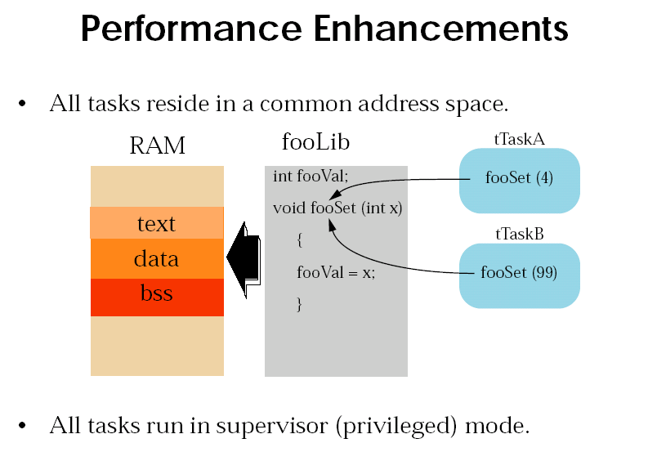
VxWorks RTOS

Slide 9
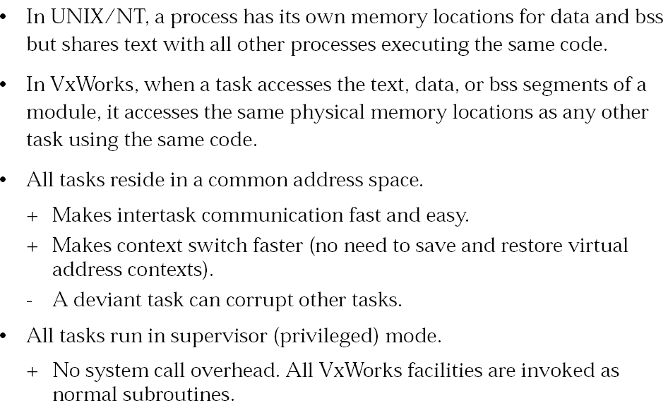
VxWorks RTOS

Slide 10
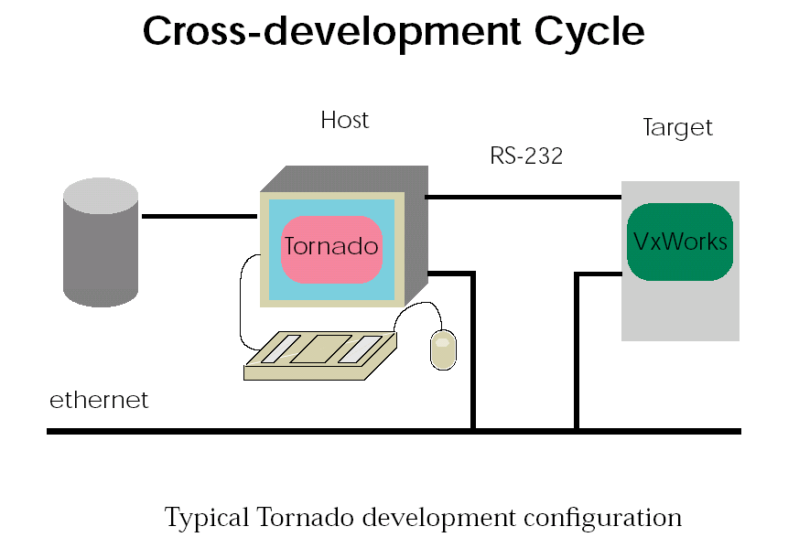
VxWorks RTOS

Slide 11
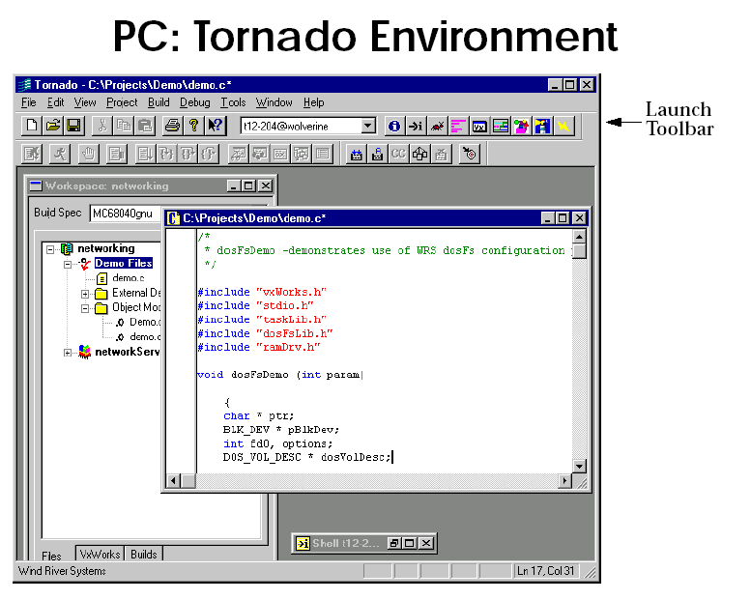
VxWorks RTOS

Slide 12
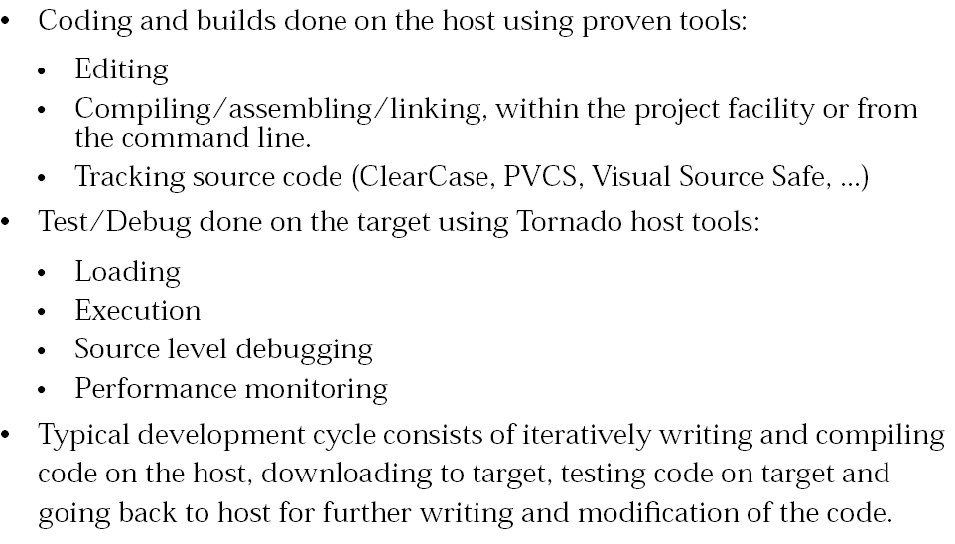
VxWorks RTOS

Slide 13
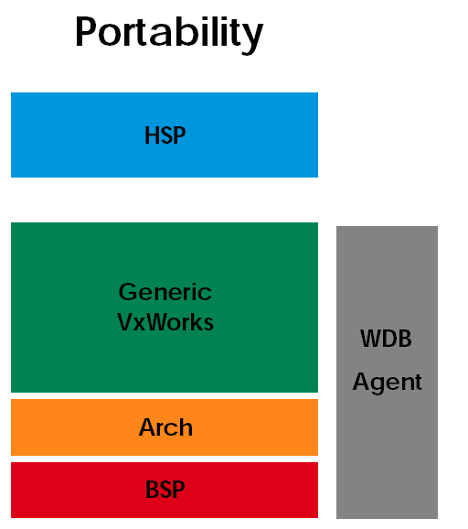
VxWorks RTOS

Slide 14
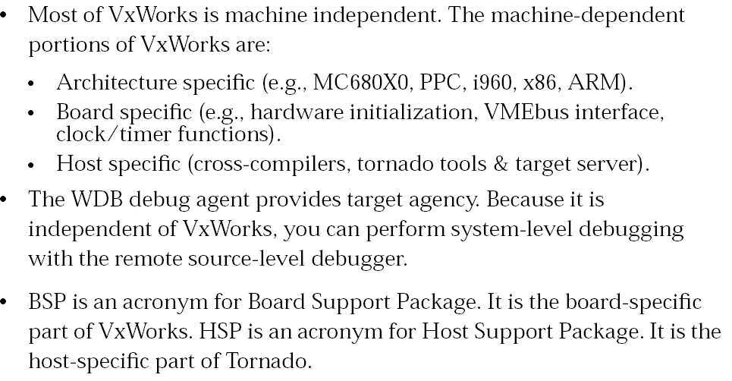
VxWorks RTOS

Slide 15
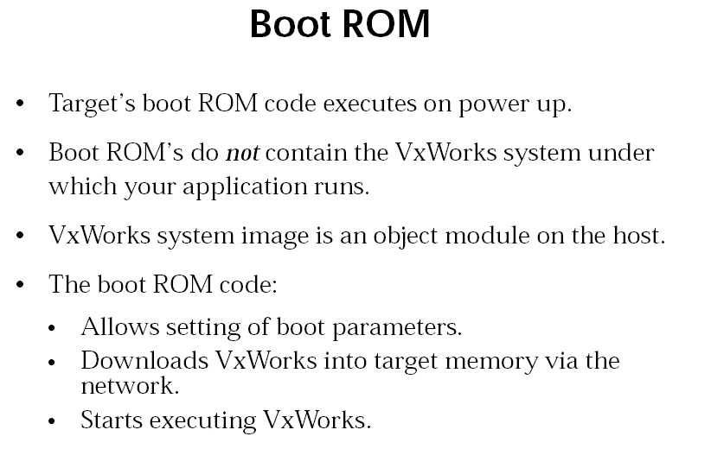
VxWorks RTOS

Slide 16
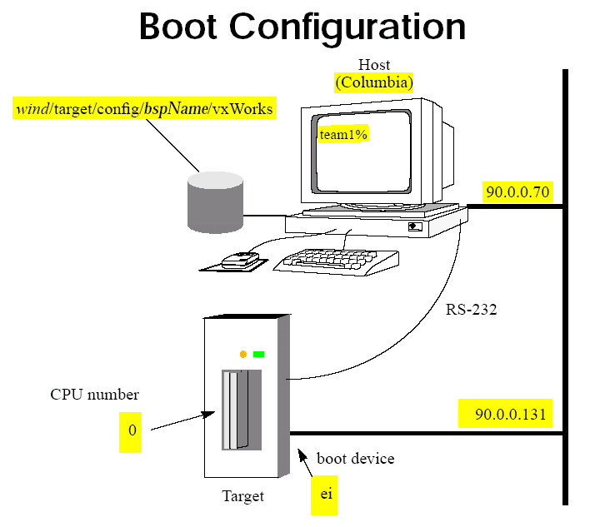
VxWorks RTOS

Slide 17
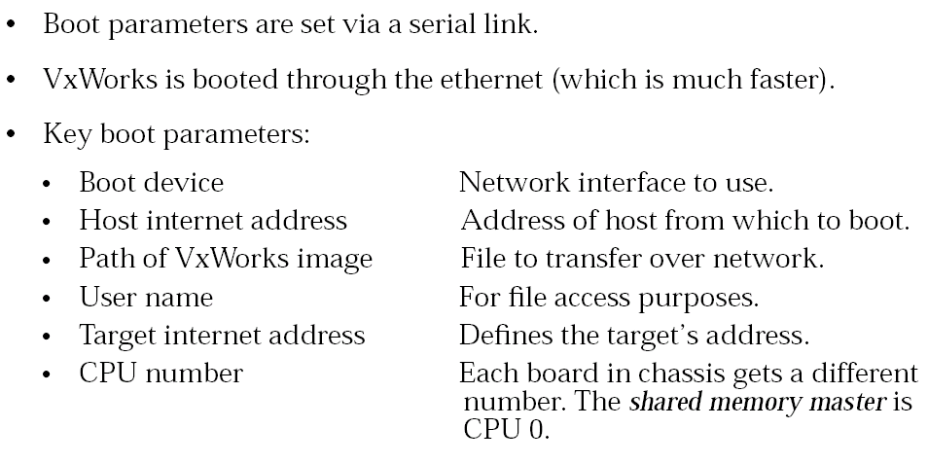
VxWorks RTOS

Slide 18
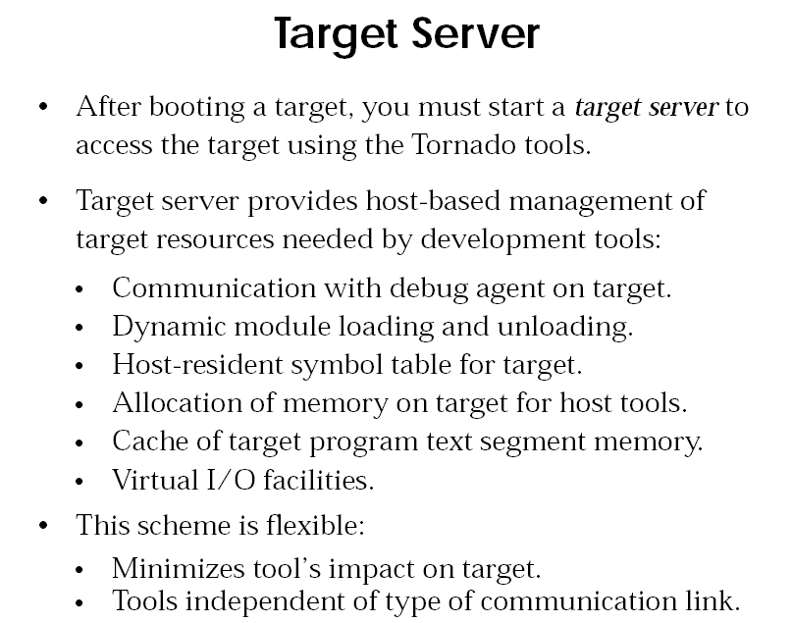
VxWorks RTOS

Slide 19
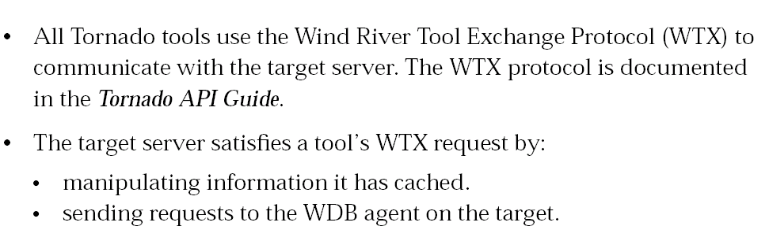
VxWorks RTOS

Slide 20
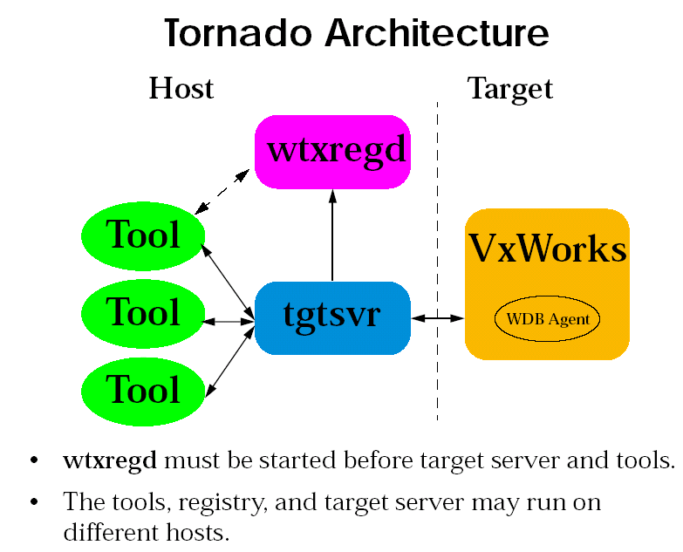
VxWorks RTOS

Slide 21
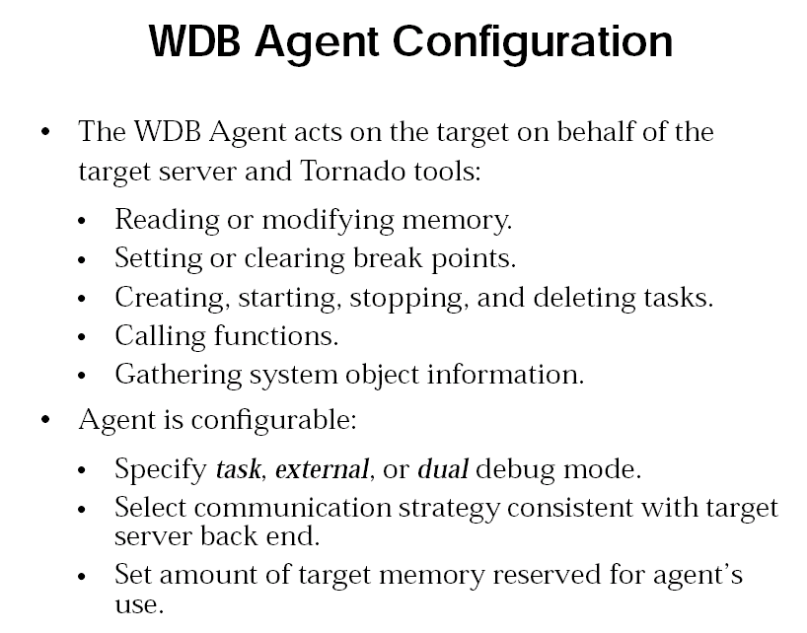
VxWorks RTOS

Slide 22
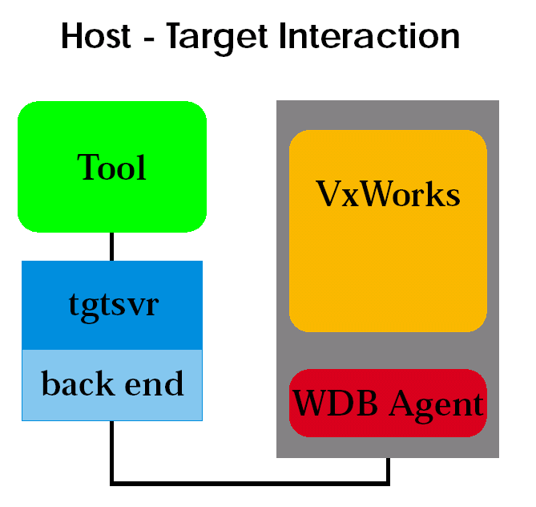
VxWorks RTOS

